Slide 1




The Brain Imaging Data Structure (BIDS)

Slide 2
BIDS is The Brain Imaging Data Structure
Who has heard about BIDS?
What is BIDS?
BIDS is a standard for organizing neuroimaging++ data
It is a document that describes the standard
It is a community of practice that develops the standard and the surrounding tools

Slide 3
The FAIR principles
Findable
Accessible
Interoperable
Reusable
Wilkinson et al. (2016)

Slide 4
The FAIR principles
Findable
Accessible
Interoperable
Reusable
Wilkinson et al. (2016)

Slide 5

Why BIDS?
Easier data sharing and reuse
Makes it easier for the person accessing a shared dataset
But also for the person sharing the data!
Interoperability across datasets and software tools makes analysis easier and more reproducible

Slide 6
Why BIDS?
Easier data sharing and reuse
Makes it easier for the person accessing a shared dataset
But also for the person sharing the data!
Interoperability across datasets and software tools makes analysis easier and more reproducible

Slide 7
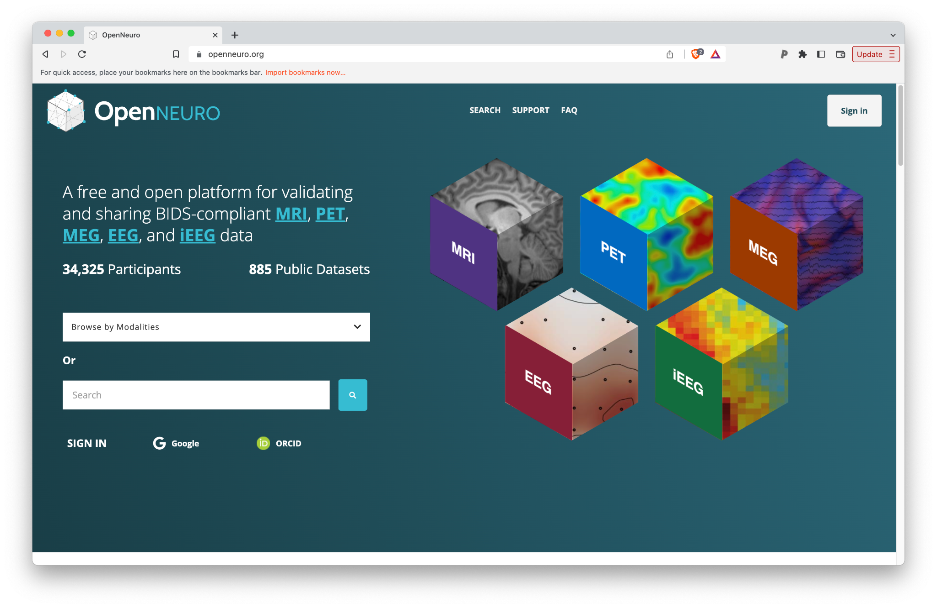
Standards-compliant data sharing
(and also funder-mandate compliant)
Markiewicz et al. (2022)

Slide 8
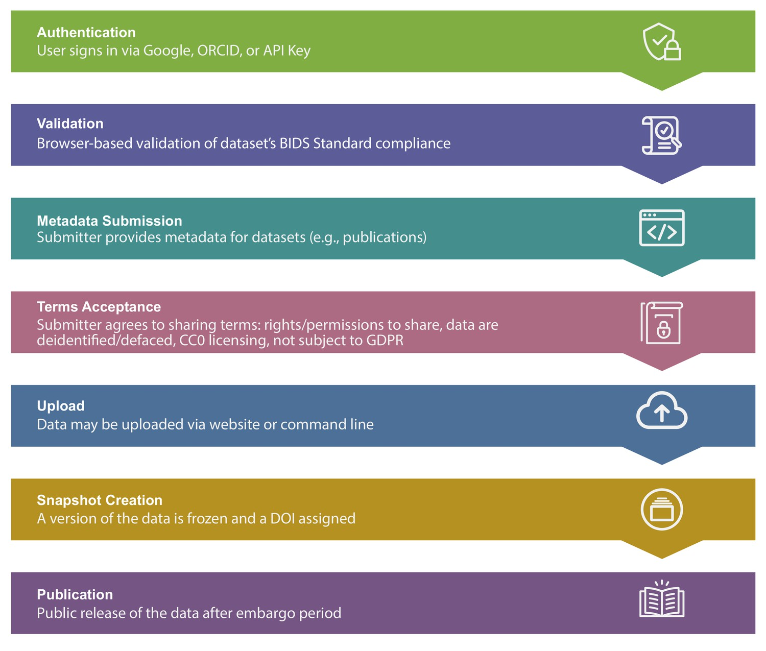
Markiewicz et al. (2022)

Slide 9
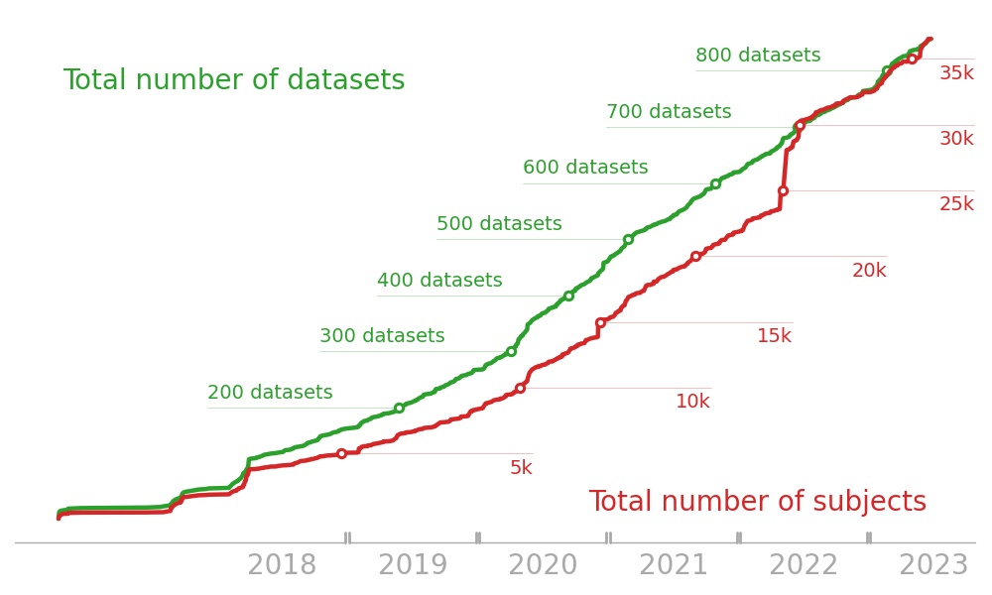
Markiewicz et al. (2022)

Slide 10
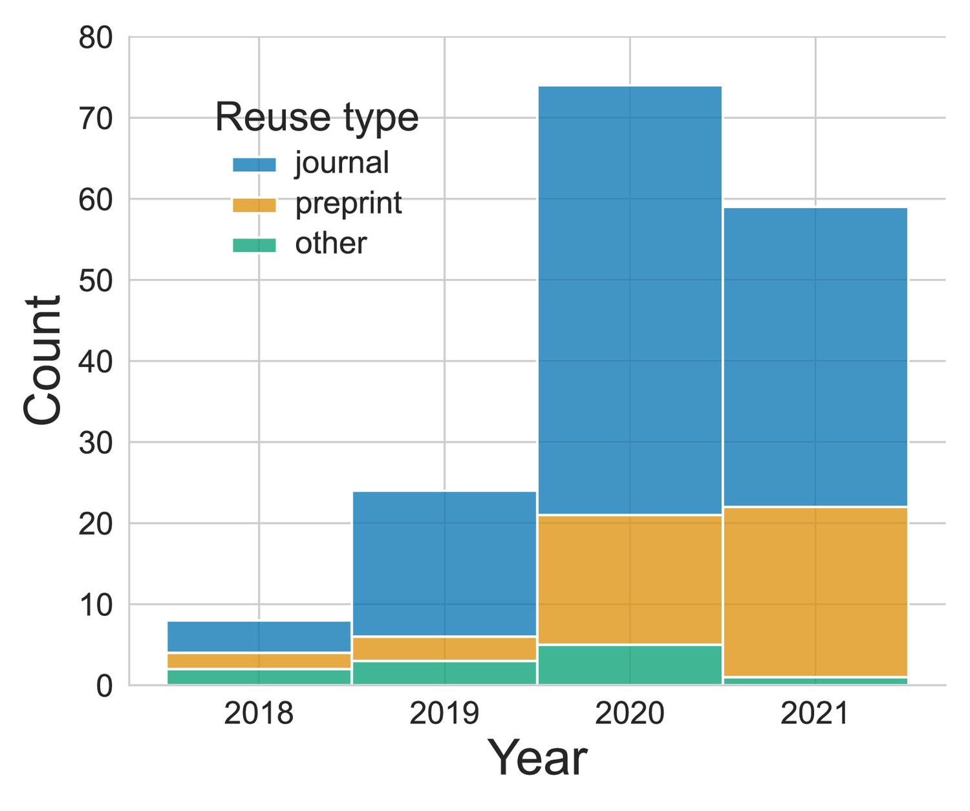
Markiewicz et al. (2022)

Slide 11
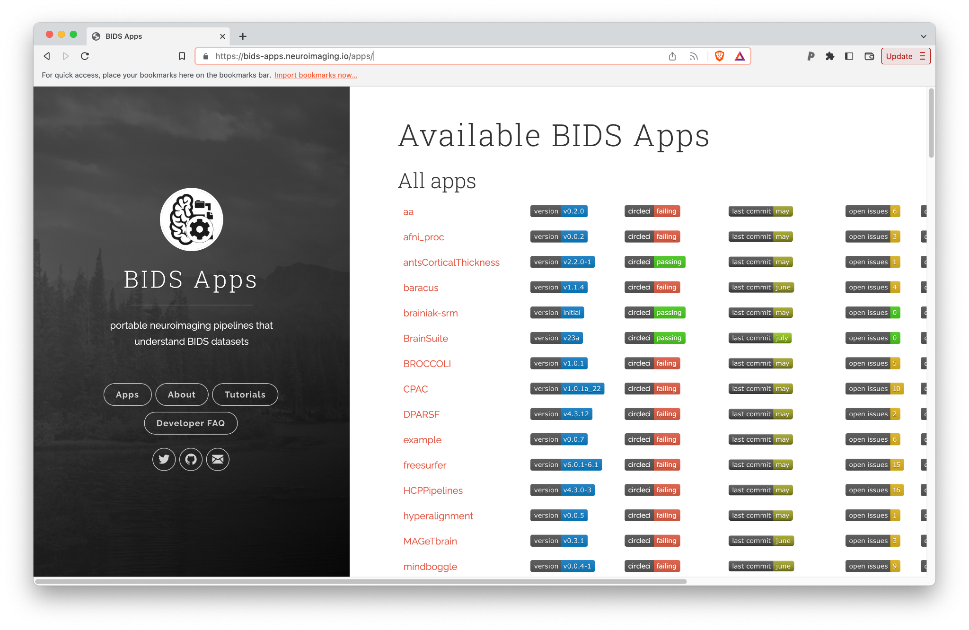
An eco-system of standards-compliant software
Gorgolewski et al. (2017)

Slide 12
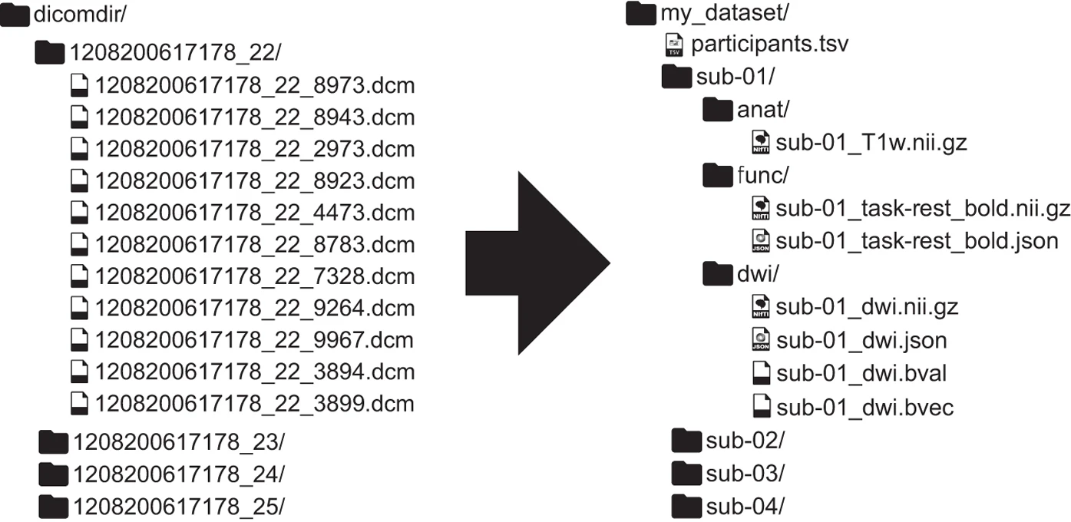
How does it work?
Gorgolewski et al. (2016)

Slide 13
BIDS does the following things
● Modularizes data
● Specifies a folder structure
● Names files in a human AND machine friendly way
● Uses standard interoperable file formats
● Documents metadata
● Minimizes duplication (inheritance principles)
Thanks: Remi Gau, https://zenodo.org/record/5872274

Slide 14
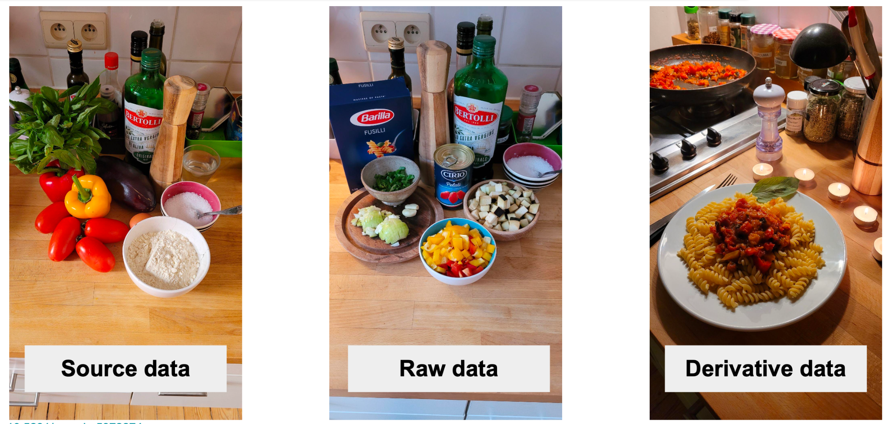
Modularizes the data
Thanks: Remi Gau, https://zenodo.org/record/5872274

Slide 15
Modularizes the data
└─ my_dataset-1/
├─ sourcedata
├─ ...
├─ rawdata/
│ ├─ dataset_description.json
│ ├─ participants.tsv
│ ├─ sub-01/
│ ├─ sub-02/
│ └─ ...
└─ derivatives/
├─ pipeline_1/
├─ pipeline_2/
└─ ...

Slide 16
Specifies a folder structure
└─ my_dataset-1/
├─ dataset_description.json
├─ participants.tsv
├─ sub-01/
└─ ses-01/
└─datatype/
├─ sub-01_ses01_T1w.nii.gz
├─ sub-01_ses01_T1w.json
├─ sub-02/
…
└─ my_dataset-1/
├─ sub-01/
└─ ses-01/
└─too/
└─many/
└─folders/
└─make/
└─it/
└─hard/
└─to/
└─nagivate/
Thanks: Remi Gau, https://zenodo.org/record/5872274

Slide 17
Specifies a folder structure
└─ my_dataset-1/
├─ dataset_description.json
├─ participants.tsv
├─ sub-01/
└─ ses-01/
└─datatype/
├─ sub-01_ses01_T1w.nii.gz
├─ sub-01_ses01_T1w.json
├─ sub-02/
…
└─ One_folder_is_hard_to_organize/
├─ sub-01_ses-01_anat_T1W.nii
├─ sub-01_ses-01_func_task-naming_bold.nii
├─ sub-01_ses-01_func_task-rest_bold.nii
├─ sub-01_ses-02_anat_T1W.nii
├─ sub-01_ses-02_func_task-naming_bold.nii
├─ sub-01_ses-02_func_task-rest_bold.nii
├─ sub-02_ses-01_anat_T1W.nii
├─ sub-02_ses-01_func_task-naming_bold.nii
├─ sub-02_ses-01_func_task-rest_bold.nii
├─ sub-02_ses-02_anat_T1W.nii
├─ sub-02_ses-02_func_task-naming_bold.nii
├─ sub-02_ses-02_func_task-rest_bold.nii
Thanks: Remi Gau, https://zenodo.org/record/5872274

Slide 18
Folder naming
Separate folders for each subject/[session] and for different measurement “modalities”:
anat
perf
dwi
func
beh
eeg
meg
ieeg
micr
pet
Thanks: Remi Gau, https://zenodo.org/record/5872274

Slide 19
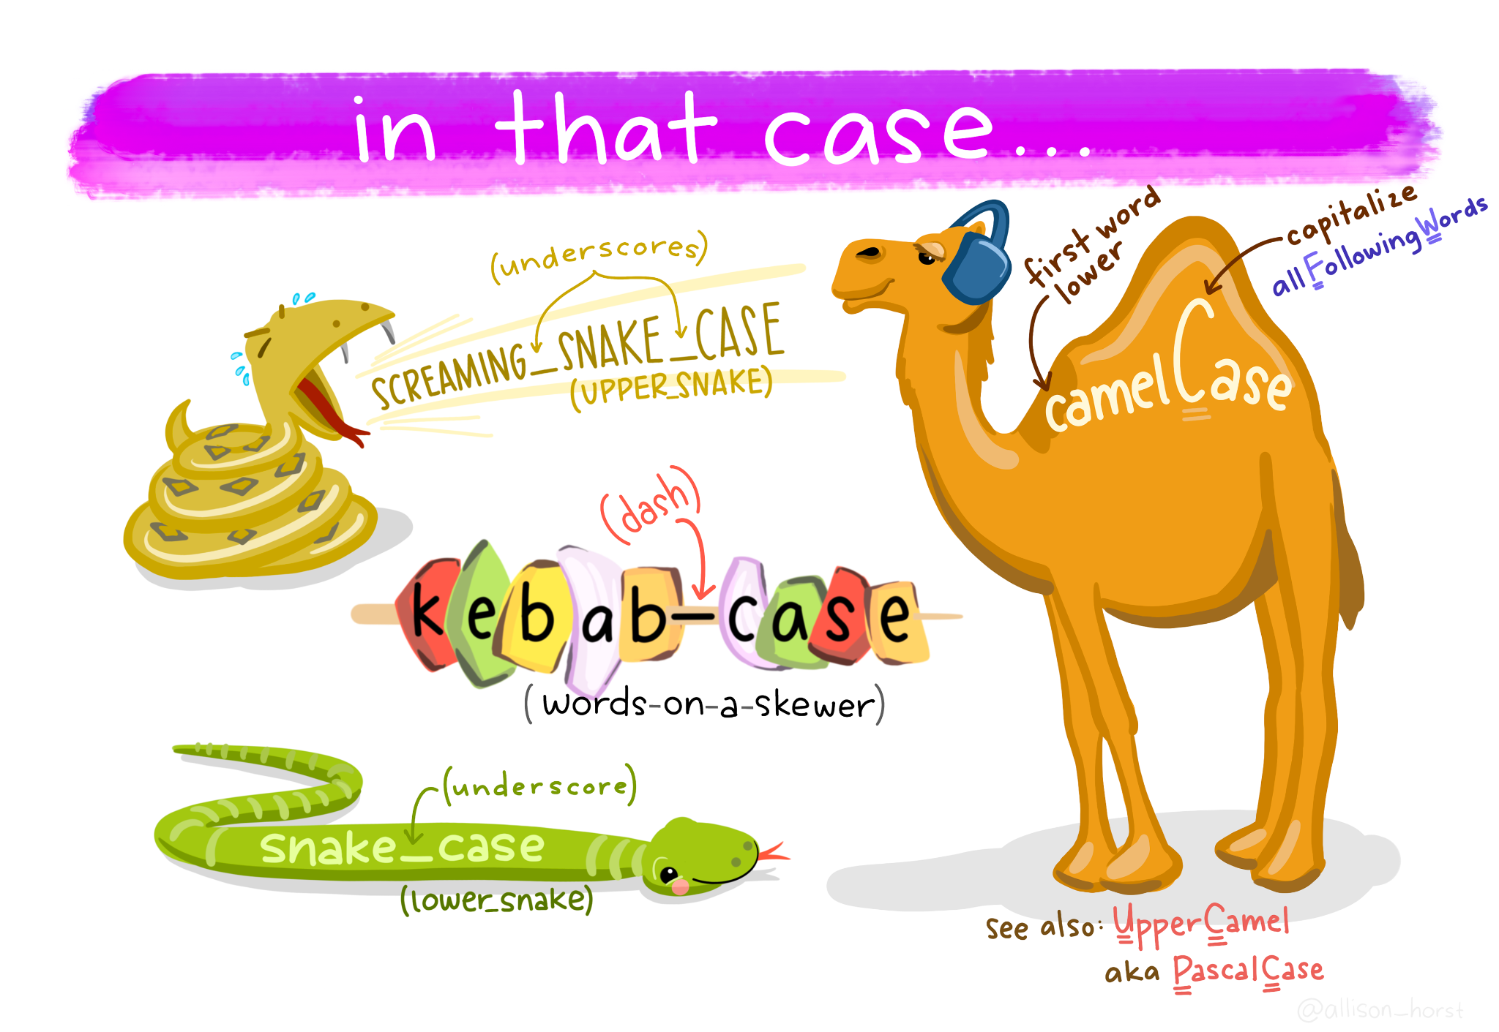
File naming that is machine and human readable
A note on file naming
Computers don’t like white-space in file names!
While camelCase and UpperCamel can work in code, some OS don’t make a distinction between Upper and lower case file-names
BIDS file-naming judiciously uses a combination of “snake_case” and “kebab-case”
From: https://allisonhorst.com/everything-else

Slide 20
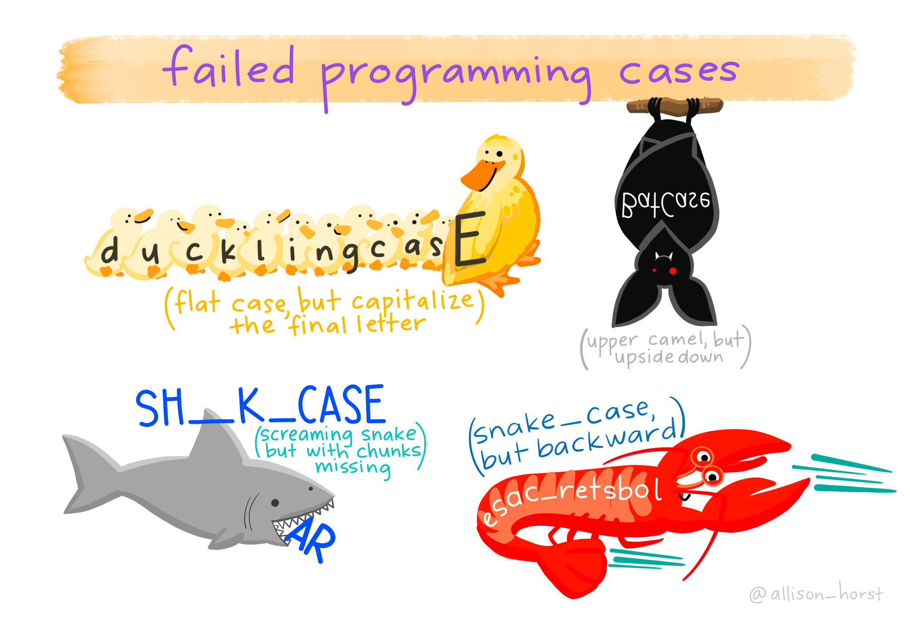
These are all not things you should (or can) do
From: https://allisonhorst.com/everything-else

Slide 21
The anatomy of a BIDS filename
key1-value_key2-value_suffix.extension
entity 1 entity 2
Suffix preceded by an underscore
Entities are composed of key-value pairs
Keys, values, suffixes can only contain letters and/or numbers.
Thanks: Remi Gau, https://zenodo.org/record/5872274

Slide 22
The anatomy of a BIDS filename
key1-value_key2-value_suffix.extension
entity 1 entity 2
“sub-control1” and “task-nback ”are entities
“T1w” and “scans” are suffixes
“nii.gz” and “tsv” are extensions
Thanks: Remi Gau, https://zenodo.org/record/5872274

Slide 23
Why is this a good thing
Machine readable
>>> path = "./sub-control01_ses-pre_task-rest_run-01_bold.nii.gz"
>>> parse_file_entities(path)
{'subject': 'control01',
'session': 'pre',
'task': 'rest',
'run': 01,
'suffix': 'bold',
'extension': '.nii.gz'}
BUT: It’s also human readable at the same time!
Thanks: Remi Gau, https://zenodo.org/record/5872274

Slide 24
A controlled vocabulary
Limited set of suffixes for each data type (“bold”, “dwi”, “T1w”, …)
● For a given suffix:
○ some entities are required
○ some others are optional
● Entities have a specific order in which they must appear in filename.
- subject
- session
- sample
- task
- acquisition
- run
…
https://bids-specification.readthedocs.io/en/latest/appendices/entity-table.html
Thanks: Remi Gau, https://zenodo.org/record/5872274

Slide 25
Uses standard interoperable file formats
Neuroimaging data uses the ubiquitous NiFTI file format (and only the NiFTI file format!)
Tabular data stored in tsv files (and rarely also csv)
Metadata is stored in json

Slide 26
Speaking of metadata
It is RECOMMENDED that each data file be accompanied by a side-car file that contains metadata (and in some cases REQUIRED)
participants.tsv
participants.json
participant_id sex age
sub-01 M 28
sub-02 F 21
sub-03 F 27
sub-04 M 25
sub-05 F 20
sub-06 M 20
{
"age": {
"Description": "Age of the participant",
"Units": "years"
},
"sex": {
"Description": "Sex of the participant",
"Levels": {
"M": "Male",
"F": "Female"
}
}
}

Slide 27
Automatic validation
Validating a BIDS dataset: https://bids-standard.github.io/bids-validator/

Slide 28
Examples
https://bids-standard.github.io/bids-examples/

Slide 29
Getting started
The BIDS Starter Kit
Provides a relatively gentle entry into the BIDS ecosystem
(might be a good idea to read first, before diving into the spec)
https://bids-standard.github.io/bids-starter-kit/
Includes useful resources such as templates for data from different modalities, etc.

Slide 30
How can I get involved?
Start using BIDS with your own data!

Slide 31
Getting your source data into BIDS
??

Slide 32
Getting your source data into BIDS
Software for dicom => BIDS conversion
Software:
Heudiconv (“Heuristic dicom conversion”): https://heudiconv.readthedocs.io/en/latest/
dcm2bids: https://unfmontreal.github.io/Dcm2Bids/3.0.1/
Web app:
ezBIDS: https://brainlife.io/ezbids/

Slide 33

How can I get involved?
Start using BIDS with your own data!
Ask questions when you get stuck: https://neurostars.org/

Slide 34
How can I get involved?
Teach others how to use BIDS!
The starter kit is (again) a good place to start

Slide 35
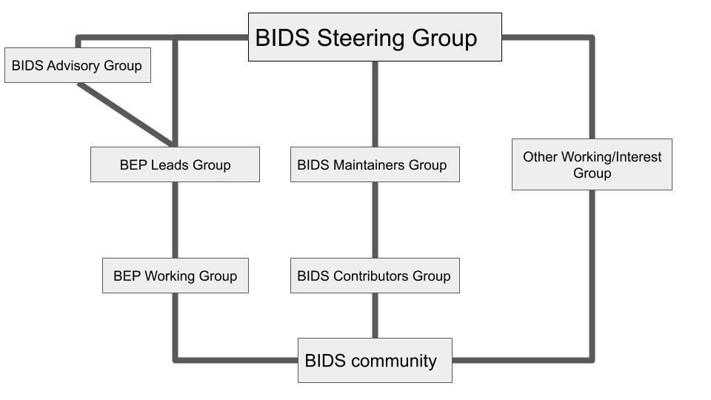
How can I get involved?
BIDS is a community-driven project!
https://bids.neuroimaging.io/governance.html

Slide 36
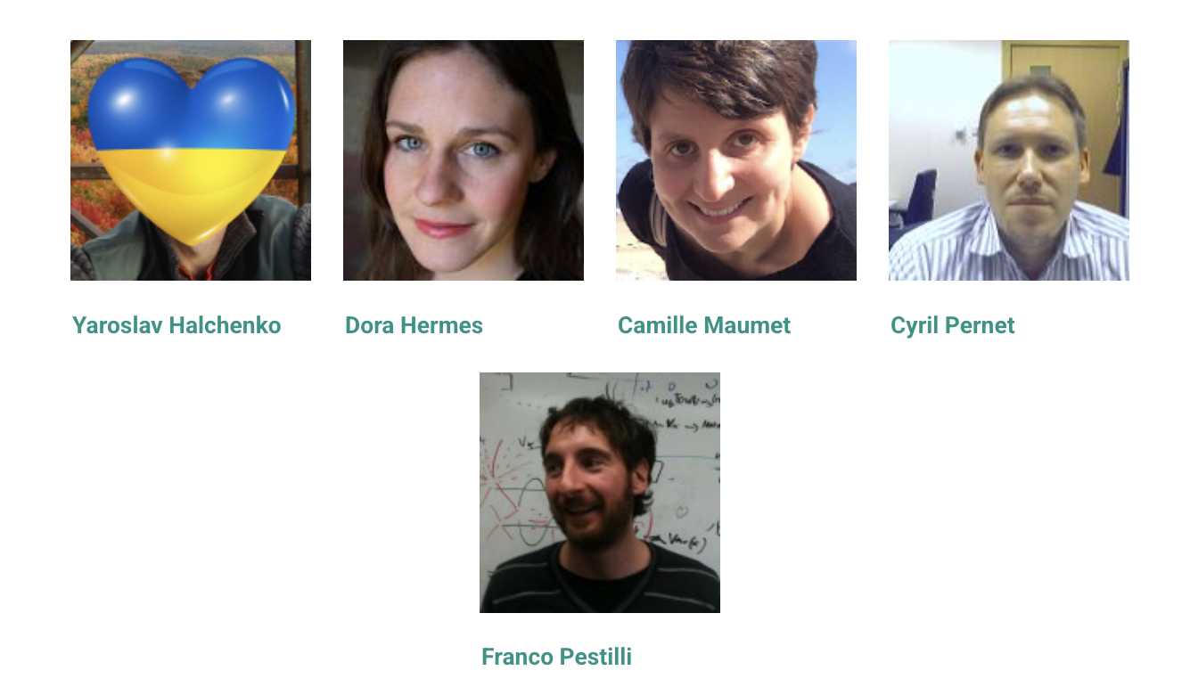
BIDS governance
The steering group
The steering group provides overall direction for the community
Helps facilitate decision making
Elected by members of the community
Serve for two years in non-overlapping terms
Elections for two seats are coming up this Fall!

Slide 37
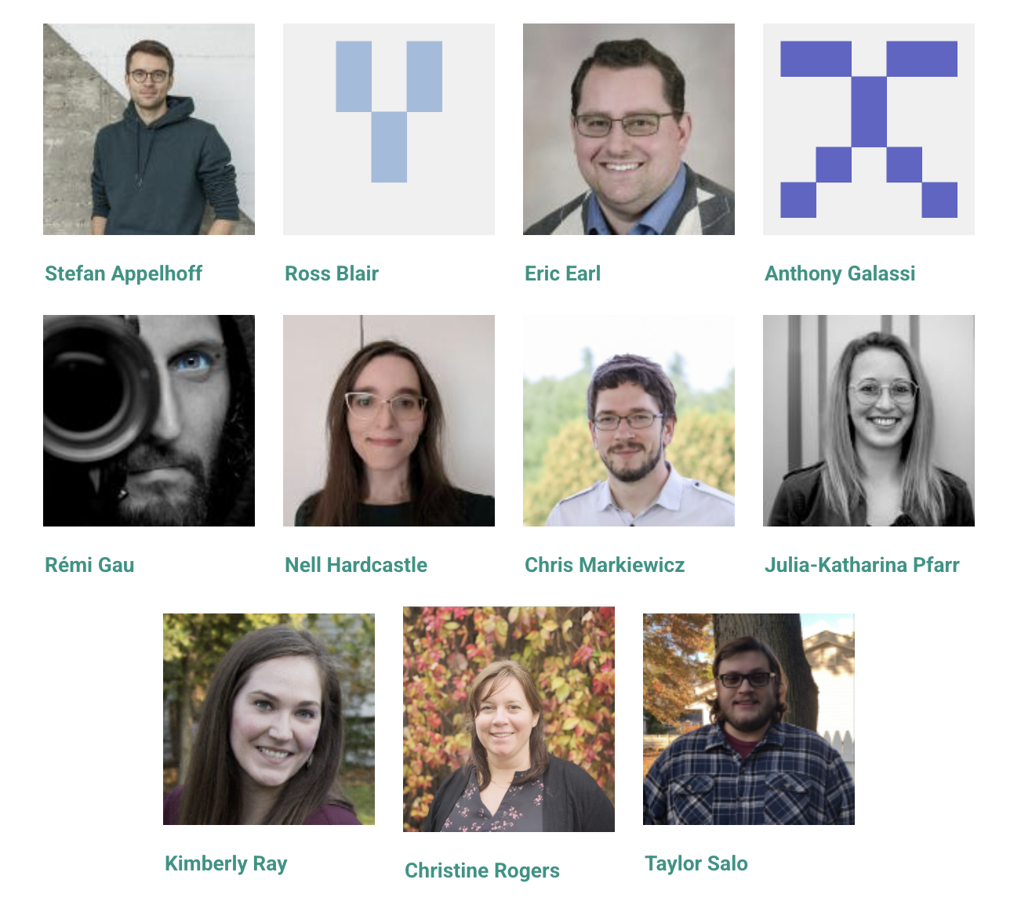
BIDS governance
The maintainers group
The maintainers are committed to work on certain aspects of BIDS
A range of different activities:
Development and maintanence of the spec
D&M of surrounding tools
Documentation
Community management
…
Often their work is funded through grants related to BIDS
Or working on BIDS is otherwise “part of their job”
The group is not limited in size or term
Hint, hint

Slide 38
BIDS governance
How can I get involved? Any and all of the above
The BIDS community
More than 200 contributors!
Many different kinds of contributions:
Writing parts of the spec (we’ll talk about that a bit more later)
Software related to BIDS
Documentation
Teaching materials
Organizing events
Raising funding
…

Slide 39
How can I get involved?
Proposing an enhancement to the BIDS specification
The BEP process:
Something is missing in the spec!
Is someone already addressing this?
Explore the specification and the BEP lists. Someone may have already done work for you.
Read the BIDS governance document.
Familiarize yourself with the BIDS community. Browse the issues and pull requests the BIDS specification repository.
Search for issues relating to your feature or BEP idea before creating a new issue.
If you find nothing, open issue on the BIDS specification repository
This is an important step before proceeding in order to make sure that more consensus arises and more contributors are aware what is happening.
Communicate with the BIDS maintainers to make your BEP official.
This entails registering the BEP with a number on the BIDS website. To obtain a number for your BEP, follow the previous steps and then open a new issue or submit a pull request to the website GitHub repository, cross-linking to any other already existing issues.
Create a draft of your extension by discussing among colleagues.
The BIDS Extension Proposal template provides some boilerplate and formatting conventions.
List on the draft the contributor(s) leading the effort.
Share the draft (remember to share a link that allows anyone to comment) with the bids-discussion mailing list and ask for comments.
Incorporate the feedback and strive for consensus.
Create example datasets
Help to merge the extension into the main specification (this will require converting the proposal to Markdown and submitting a Pull Request at the BIDS specification repository)
If necessary, contribute a pull request to the BIDS Validator repository as well to incorporate the extension.
https://bids-extensions.readthedocs.io/en/latest/

Slide 40
Some links
BIDS website: https://bids.neuroimaging.io/
BIDS specification: https://bids-specification.readthedocs.io/en/stable/
BIDS starter kit: https://bids-standard.github.io/bids-starter-kit/

